Slide 1
Presentation on Waterfall Projects

Slide 2
Projects In WaterFall:
1. CRLETA
2. CREXDM
3. BREXIT
4. SIERRA
5. NAFTA SSO
6. T2W
7. IE
8. Logo Changes
9. Invoice Text Modification

Slide 3
1. CRLETA
ETA means Expected Time of Arrival.
Introduction: Changes related to CRLETA deals with Order Processing.
This project is related to delivery date for the order that has been placed.
Before this logistics project, we are displaying either the shipping date (or) delivery date.
So, with the logistics project we are displaying both the shipping and delivery date for the markets given by business. Delivery date is displayed as a RANGE instead of single value.

Slide 4
Overview:
Until the deployment of this project in production, what is happening is..
We have only delivery date and shipping date where delivery date is calculated based on lead time.
Example: We are placing an order today (14th jan), then
Expected delivery date = The date of today’s + Lead Time (Number of days or hours required for order to be shipped and reached directly to the customer).

Slide 5
Now, we have introduced one more field, one more date i.e, “Lead Time max”.
Expected shipping date = (the date of order placed + Lead Time ) to (the date of order placed + Lead Time Max)
To provide a range of dates for the delivery date.
The delivery can be delivered between 14th of January – 16th of January
So, this project Logistics-ETA, we have introduced a new value, new range of date for the delivery time (delivery date).

Slide 6
2. CREXDM
Introduction: Changes related to CREXDM deals with Order processing
The project CREXDM means Excess Demand.
Excess number of pieces we are placing an order for a part.
For example:
If we are placing an order of 10 – pieces and maximum quantity that is allowed on this particular part, that is being placed is 6 – pieces.
So, until now what’s happening is all the 10 – pieces are going into back-order due to the Excess Demand Logic.
New CR:
Now with the new CR, we made the changes as if
For the 10 – pieces, if 6 – pieces is the maximum then all the 6 will go into assigned stare (or) allocated state

Slide 7
The other 4 – pieces will go into back-order state.
This calculation would be different for normal order and urgent order.
For normal order, we keep everything (10 – pieces) in back order first. Then we will process it based on maximum quantity and then we will allocate it during night batch allocation process.
For urgent order, the maximum number of pieces will be allocated first. Then the remaining pieces will be going into back order and will be processed based on release date.
So, this is how we have managed the logic in CR.
Till now all the 10 – pieces are going into back order. Now we have separated it and split it into 2-records.
i) One with max.
ii)Other with rest of pieces in back-order state.

Slide 8
3. BREXIT
Introduction:
In the current CR / project we are dealing with invoicing process.
CR’s:
There are two CR’s that are completed in 2021
CR-1:
The first one is Brexit ICY consolidation. That is Inter Company Consolidation.
When we are sending the order, if it is an international shipping between one country to other country, (ex: Italy and France) there will be custom charges.
Instead of taking customs into picture for each and every order that is being placed, what we did is Inter Company Consolidation.
That is all companies are consolidated into one, so that we can reduce the custom charge.

Slide 9
The all orders that are being placed under a similar customer all those parts are being consolidated into a single box. So, that custom charge will be less. This is Inter Company Consolidation.
Basically, what’s happening is..
One’s we place parts as an order, and they are available for shipping they will be arranged in boxes and those boxes will be shipped. Instead of shipping single part the whole boxes containg of parts will be shipped. Finally custom charges will be reduced.
CR-2:
The second CR is Automatic protocol.
There are many logics involved when we go to Invoicing an Order.
When it comes to invoicing, there is this particular flow called protocol which will start the invoicing process.

Slide 10
That protocol we used to do it in online screen manually. We have to select that trip and protocol the invoice.
Instead, there is new CR that ONSHORE team has finished called automatic protocol.
It will automatically start the invoicing process (protocol) without any manual intervention.
These are two CR’s that are done for BREXIT.

Slide 11
4. SIERRA
Introduction: Changes related to Sierra deals with CLAIMS
This sierra project is about making some additional changes in our csps project.
We have some additional warehouses. For those warehouses we need to manage some different logics for the customers.
So, some additional changes has been implemented and there has been some functionalities which are added through existing application.
CR:
In this particular change request, we were asked to add the additional check box in the part master online transaction.

Slide 12
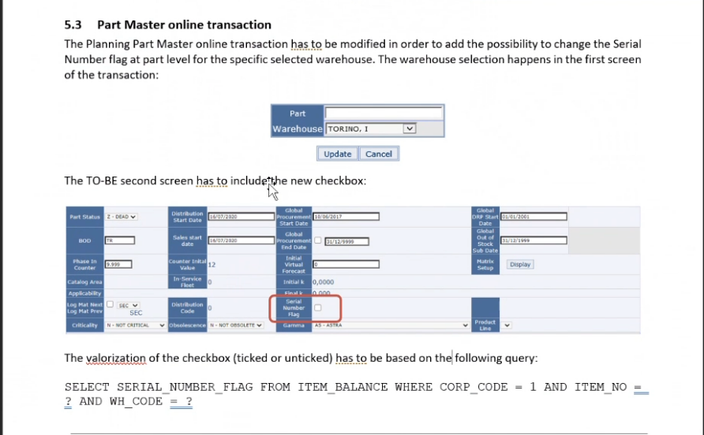

Slide 13
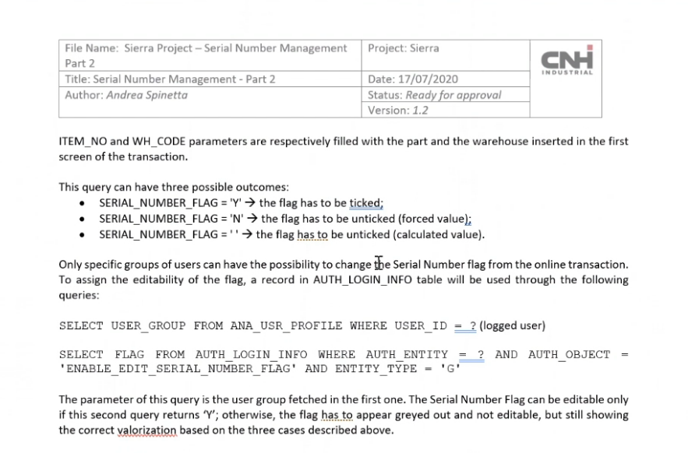
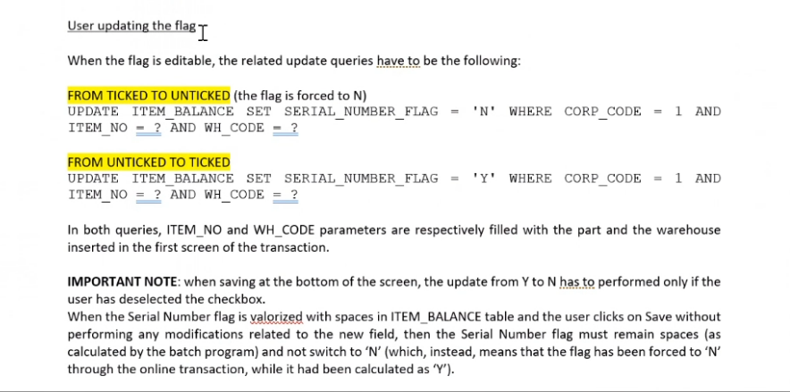
This is the first FD of the sierra project.
If we click on the check box some request would be populated and it should be inserting or it should be selecting as per the logic provided.

Slide 14
We modify the Buy-Back transaction. It will manage possibility to return the buy-back to the depot difference to the marketing unit.
Earlier what happened is, there is a common functionality to the CORE and NON-CORE part. Like we get the online screen, where we process both the core & non-core using same functionality.
So, using the new logic if the buy-back will be marked as core buy-back we have designed different functionalities for both core and non-core part.
By this CR we can separately process both the parts.

Slide 15
5. NAFTA SSO
Introduction: Changes related to NAFTA SSO deals with order processing.
Here, SSO means – Super Stock Orders
We have created a new transaction called super stock orders.
It will open in the specific time period. There are certain parts that which we can place the
orders only during certain time frame. That will come’s under this super stock order (or) harvest
season management.
There will be 2 – 3 logics that we generally apply for orders here. But apart from that everything is similar to the regular order processing logics.
There are list of PCC codes available in this SSO. We have defined the parts for each PCC code which we can order during this time period.

Slide 16
6. T2W
Introduction:
Here we created two new marketing units and we moved from one region to other region.
Example: Created two marketing units
AR08
AR14
Likewise, we have moved the AR01 and AR02 from AGCI –CSPS to CVBR.
All the module processing and everything is same, but it is new region.

Slide 17
7. IE
Introduction:
Till now our CSPS project online transactions are compatible only for internet explorer.
So, in IE project what we did is all indentation issues and all layout issues we have been fixed for other browsers.
Like google chrome, safari, mozilla firefox etc. we have made our csps project compatible to the mentioned browsers.
Now, after making the changes for some modules like Order Processing, Finance, and other main modules it is compatible.
Here changes means -> some JSP changes, CSS changes, and bootstrap, JavaScript changes are done.

Slide 18
8. Logo Changes
So, here the logo changes means. The IVECO region have designed a new logo and they want to replace it with the IVECO logo.
The logo has been changed for some regions only.
For home and log-in pages and for invoices also the logo changes has been done.
Wherever we are using CNHI portal, the IVECO Logo is replaced with New Logo.
And for ANZBR region for all the modules the logo is replaced.

Slide 19
9. Invoice Text Modification
When a product is ordered and delivered if we download the invoice, there is limitation for text.
Like there is a 500 characters limitation for printing, before making the changes.
Later they asked we want to print more lines. Then the limit of characters is changed to 4000 characters text.
So added one more field in the databases for displaying that 4000 characters and extra space for invoicing text.
This is the modification happened for the comment field in invoice and has been increased to 4000 characters long.
It’s not for all orders we will get 4000 characters space. It depends on the database value present in the order (or) specific order.

Slide 20
Thank you..

